Slide 1




Rentify PK
Pakistan's First All-in-One Car Rental Aggregator Platform
Connecting customers with local rent-a-car vendors on a unified digital app to compare prices, verify vehicle conditions, and book easily from home.
TEAM LEADER
TEAM MEMBER
TEAM MEMBER
TEAM MEMBER
Muhammad Ismail
Ali Affan Siddiqui
Muhammad Tauseen Khan
Huzaifa Mateen

Slide 2
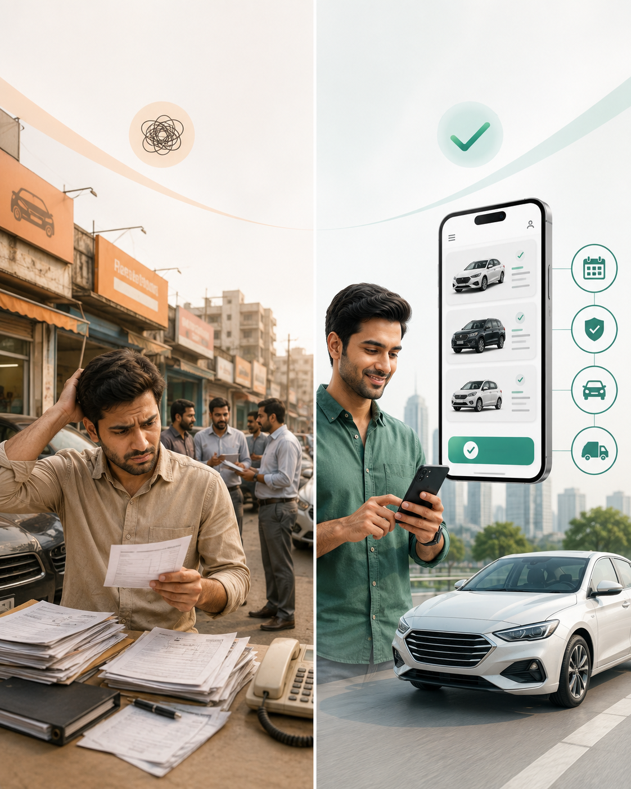


Market Need & Solution
The Problem in Pakistan
Car rentals in Pakistan are offline and fragmented. Customers physically visit multiple shops, face hidden charges, lack price transparency, and often receive poorly maintained cars without guaranteed availability.
Our Solution: Rentify PK
A single mobile app bringing local rent-a-car providers together. Compare live rates, review verified vehicle conditions, check model availability, and book instantly with doorstep delivery.

Slide 3



How It Works
Search & Filter
Compare & Inspect
Book from Home
Drive & Return
User enters city, pick-up date, duration, preferred car category (e.g. Sedan, SUV, Economy) or specific model.
Browse local vendor listings. Compare prices, inspect real car photos, read customer reviews, and check vehicle mileage.
Confirm booking with flexible payment options (EasyPaisa, JazzCash, Card, or Cash on Delivery).
Receive the car at your doorstep or pick up from vendor location with digital verification contract.

Slide 4






Core Features
Smart Price Comparison
Verified Car Condition
Doorstep Booking
Eliminates overcharging by letting users compare competitive rates across dozens of local vendors in real-time.
Every car listing includes high-res photos, recent maintenance status, mileage, and authentic user ratings.
No need to travel to markets. Complete identity check online and request car delivery directly to your home.

Slide 5






Human Resources Needed
App Developers
Vendor Managers
Digital Marketers
Customer Support
2 Tech Students to build & maintain Flutter mobile app and web admin panel using open-source tools.
Onboard local rent-a-car shop owners, verify business documents, and register vehicles onto app.
Run targeted social media campaigns (Instagram, TikTok, Facebook) & university campus drives.
1-2 Reps to handle online bookings, customer inquiries, and booking issue resolutions via WhatsApp/Phone.

Slide 6

Lean Startup Budget
As university students, we designed a ultra-low budget MVP (Minimum Viable Product) utilizing open-source technology and digital marketing:
Cost Category | Description / Resource | Estimated Cost (PKR) | Strategy
App & Domain Setup | Firebase Backend, Domain & Flutter App |  | Built internally by student developers
Social Media Ads | Targeted Facebook, Instagram & TikTok Ads |  | Hyper-local marketing in top cities
Vendor Onboarding | Print Flyers, Business Contracts & Verification |  | Direct field visits by founders
Legal & Miscellaneous | Basic Business Registration & SMS Gateway |  | Pay-as-you-go SMS API integration
TOTAL INITIAL BUDGET | Lean Bootstrap Student Capital | PKR 65,000 (~$230) | Budget Friendly Startup

Slide 7
How We Earn Money
Vendor Commission
Featured Listings
Damage Protection Fee
We charge a 5% to 8% commission fee from car rental vendors on every successful booking completed through the app.
Local rental vendors pay a monthly fee (e.g. PKR 3,000/mo) to highlight their cars at the top of customer search results.
Small optional convenience charge (PKR 300 - 500 per booking) paid by renters for basic damage coverage partnership.

Slide 8



Conclusion & Questions
Why Rentify PK Will Succeed
First-Mover Advantage: Modernizes an entirely offline market in Pakistan.
Highly Scalable: Asset-light model; we don't buy cars, we connect existing owners.
Student Budget Ready: Ultra-low initial capital required to launch MVP.
Thank You for Listening!
We are ready to answer your questions.

